Slide 1
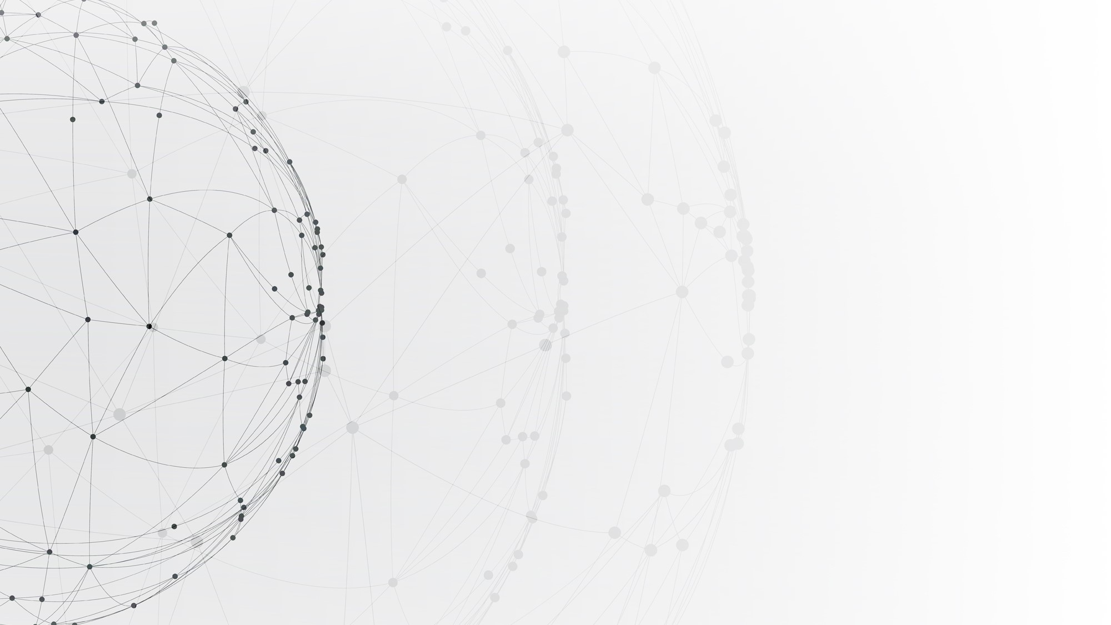
Unifying Structural Proximity and Equivalence for Network Embedding
史 本 云
南京工业大学
Email：benyunshi@outlook.com

Slide 2
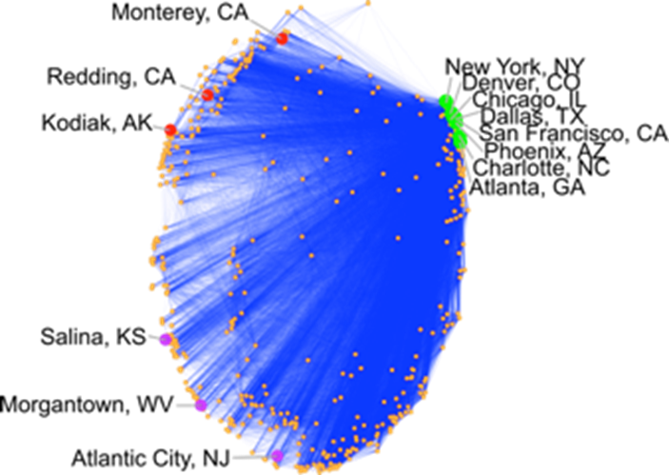
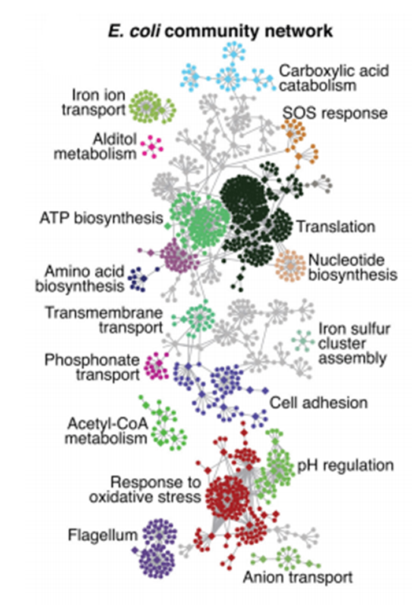
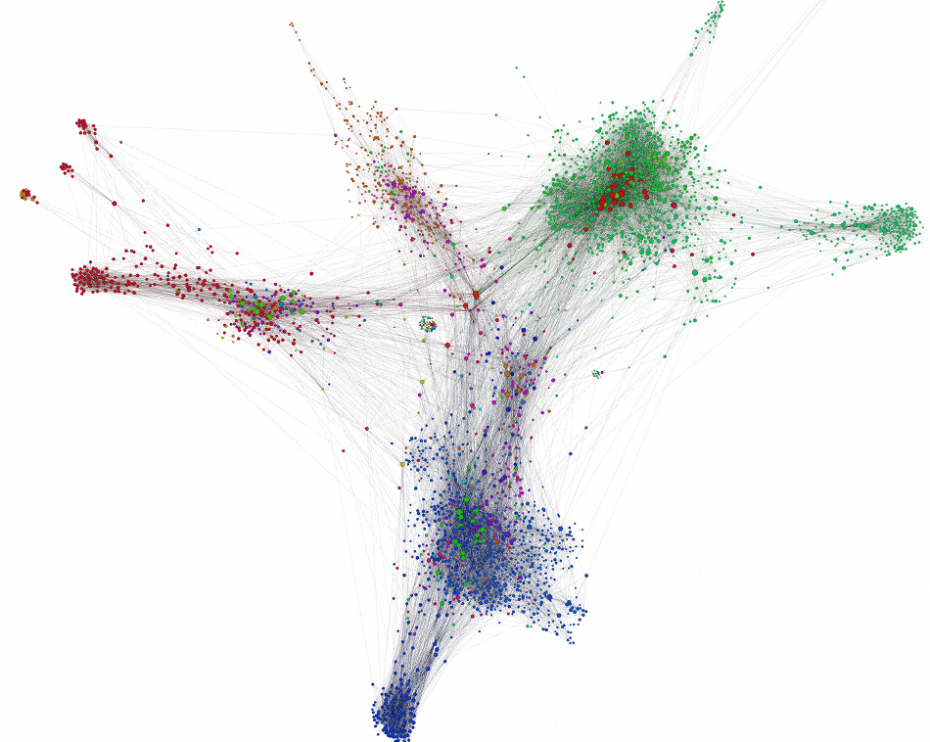
Complex Networks
Social networks
Air-traffic networks
Biomedical networks
Graphs or Networks are a general language and a ubiquitous data structure for describing and modeling complex systems.

Slide 3
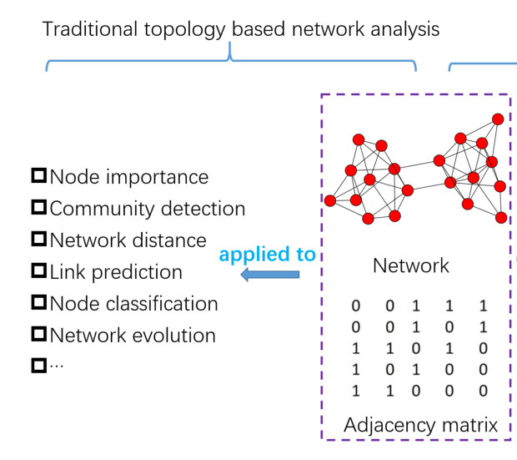
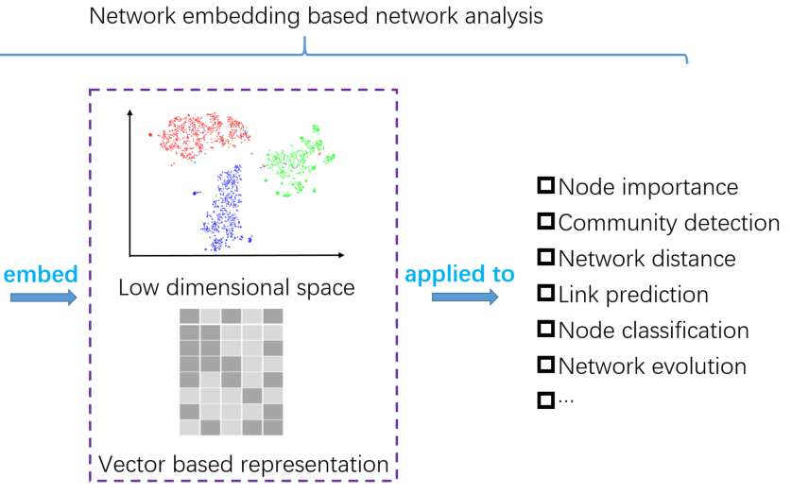
What’s Network Embedding?
features are hand-engineered by heuristics e.g., Centrality, Modularity, Clustering coefficient…
features are automatically learned
by preserving certain network properties
Cui, Peng, et al. "A survey on network embedding." IEEE TKDE 31.5 (2018): 833-852.
Notes:
application
capture the diversity of connectivity patterns observed in networks
nodes is based on feature extraction techniques which typically involve some seed
hand-crafted features based on network properties
graph embedding是学习节点隐表示向量，在一个连续向量空间中对节点的关联关系进行编码，便于计算节点之间的关联关系
是学习一种将节点作为点嵌入到低维矢量空间中同时保留其属性的映射
观测到的网络拓扑空间“嵌入”到隐含的向量空间

Slide 4
Applications of Network Embedding
Network Compression
A compression store networks more efficiently run graph algorithms faster
Visualization
Community Mining
Network partitioning ( k-means on the embedding to cluster the nodes )
Link Prediction
Predict either missing interactions or links that may appear in the future
Node Classification
Label the full graph based only on this small initial seed set
View it from an information visualization perspective
Notes:
1736 when Euler used it to solve ”Konigsberger Brucken- problem”

Slide 5
Graph Representation Learning (GRL) Problems
Type I：GRL for Structural Properties Preservation
Focuses on the topological structure and properties of complex networks
Type II：GRL on Attributed/labeled Networks
The attributes, contents, labels and other information of nodes or edges in real-world networks are considered, which provides semantic information other than structural topology for GRL
Type III：GRL based on Advanced Information
Designed for specific tasks, it is necessary to introduce specific prior information according to specific task scenarios to ensure better performance

Slide 6
Typical Network Embedding Approaches
Matrix Factorization
Representing the connections between nodes in the form of a matrix, and factorizing this matrix to obtain the embedding
Laplacian Eigenmaps (M. Belkin 2001), Graph Factorization (A. Ahmed 2013), GraRep (S. Cao 2016), HOPE (M. Ou 2016)
Random Walks
Sampling node context through random walks on networks, and obtaining embeddings by CBOW and SkipGram methods
DeepWalk (S. Skienna 2014) , Node2vec (J. Leskovec 2016)
Deep Learning
Viewing the network as a computational graph, and training the whole model in an end-to-end fashion
SDNE (Daixin Wang 2016) , GCN (Thomas N. Kipf 2017) , GraphSAGE (W.L. Hamilton 2017), GAN (P. Velickovic 2018)

Slide 7
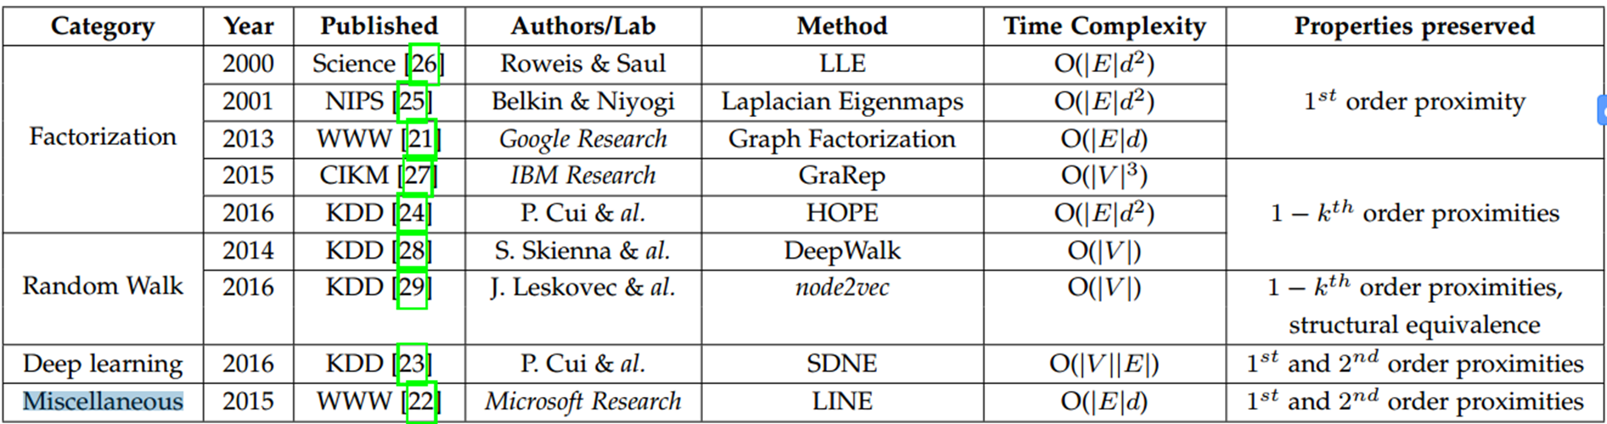
Methods that Preserve Structural Proximity
P. Goyal and E. Ferrara. “Graph Embedding Techniques, Applications, and Performance: A Survey." Knowledge-Based Systems 151 (2018): 78-94.
Notes:
1736 when Euler used it to solve ”Konigsberger Brucken- problem”

Slide 8
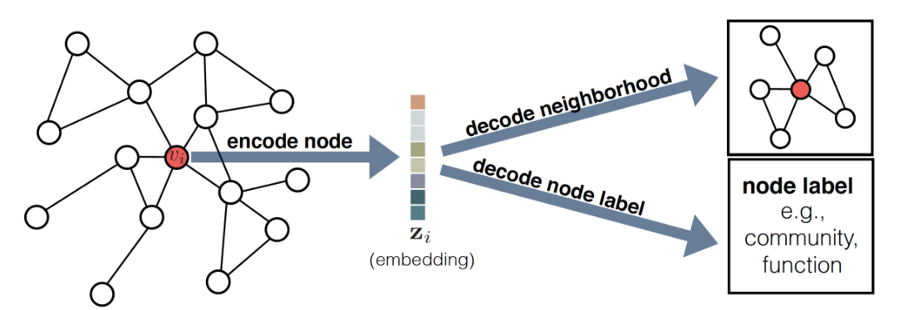
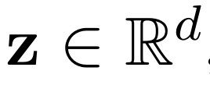
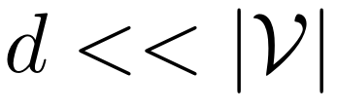
What’s Network Embedding?
Nodes in G to a vector
Preserve the original structure of network（automatically ）
Input of downstream machine learning task (efficiently and effectively )
Notes:
without handcrafted features
mathematically

Slide 9
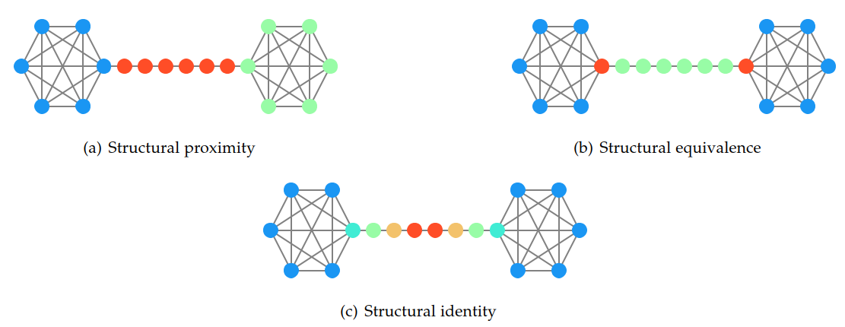
Structural Properties
Objectives: Hybrid graph embedding that flexibly preserves both structural proximity and role-based equivalence of a network.

Slide 10
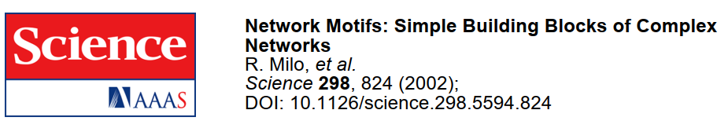
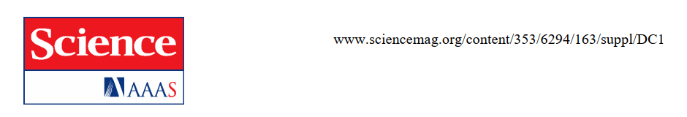
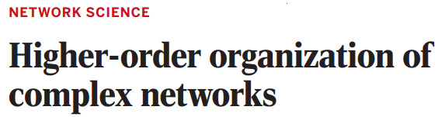
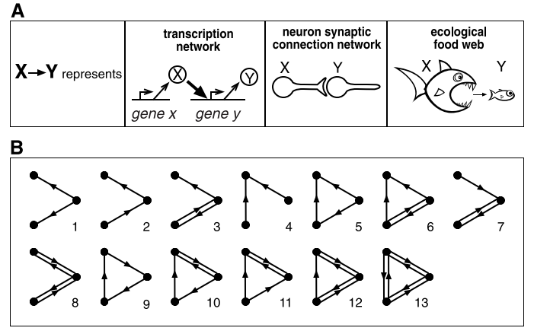
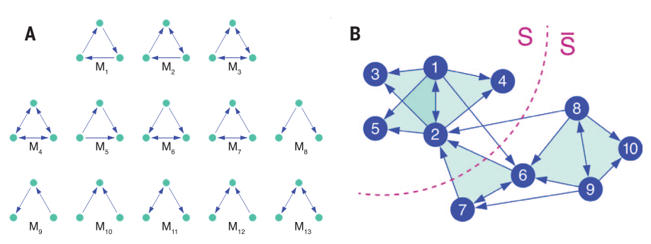
Higher-order Organization in Complex Networks
R. Milo et al, Science, 2002
A.R. Benson, D.F. Gleich, and J. Leskovec, Science, 2016

Slide 11

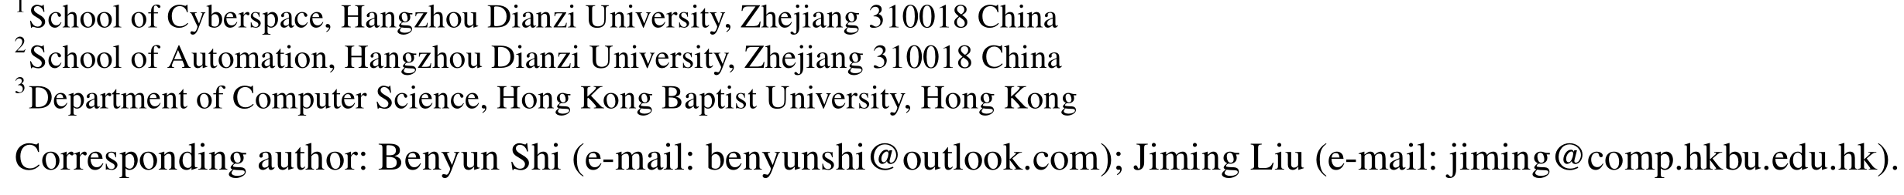
Factorization-based Approach
Unifying Structural Proximity and
Equivalence for Network Embedding
BENYUN SHI, CHUNPENG ZHOU, HONGJUN QIU, XIAOBIN XU, JIMING LIU
INDEX TERMS Graphlet degree vector, Structural proximity, Structural equivalence, Network embedding, Node classification

Slide 12
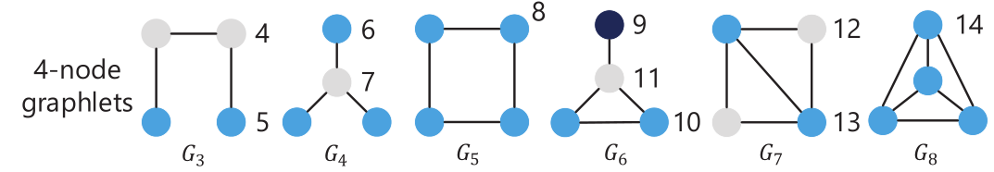
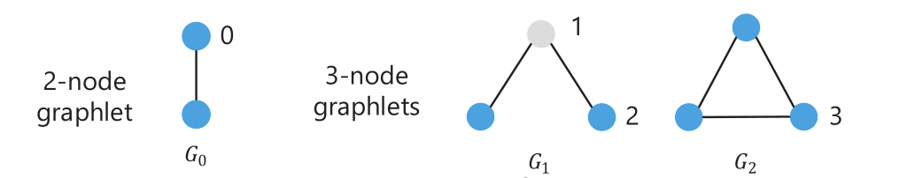
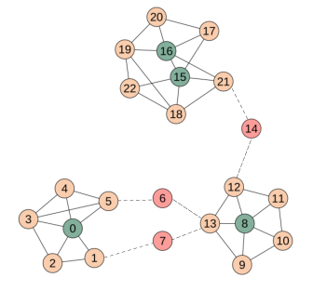
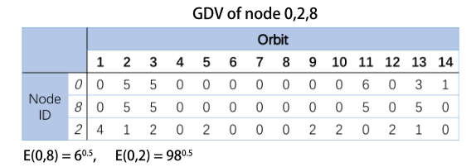
How to Capture Structural Equivalence?
The frequency of a node that take part in some small induced subgraphs (graphlet)
Use graphlet degree vectors (GDV) to bulid a similarity matrix S
$S_{ij} :$ the similarity between node i and j

Slide 13
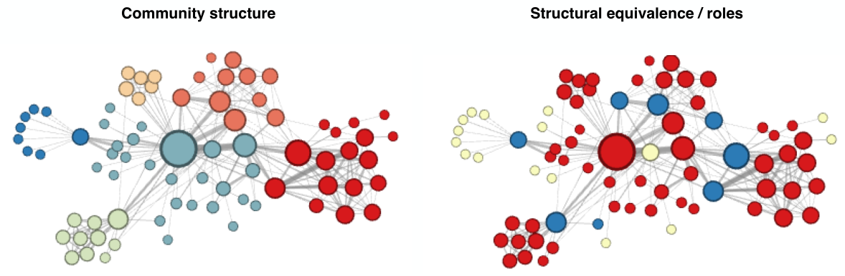
Two different views of a character-character interaction graph
Community structure: the same community（Global）
Structural equivalence: the same role （Local）
Real-world networks usually exhibit a mixture of both
Notes:
Salary is related to your company and your position

Slide 14

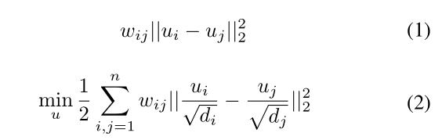
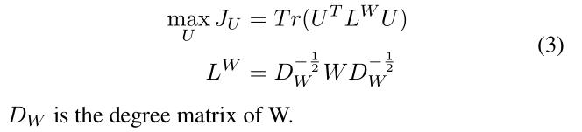
Community-Preserving Formulation
Community structure: the adjacent matrix W
Highly interconnected should be embedded closely together
U：community structures embedding

Slide 15
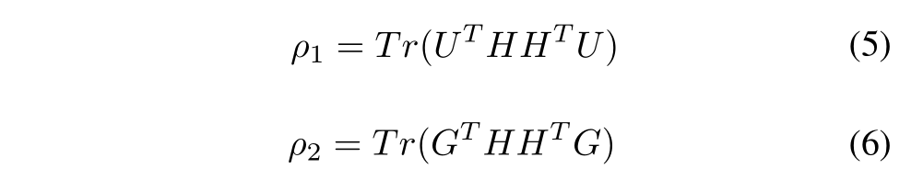
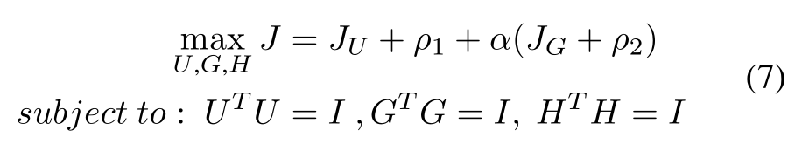
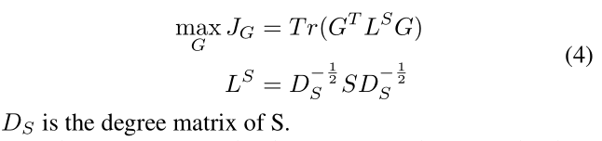
The Hybrid Embedding Method
For community structures (W) :
Project U and V into a unified embedding space:
The final objective function：
For structural equivalence (S ) :
U：Community structures embedding
G: Structural equivalences embedding
H: The final embedding

Slide 16

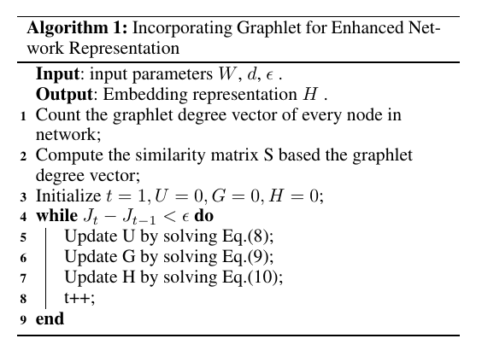
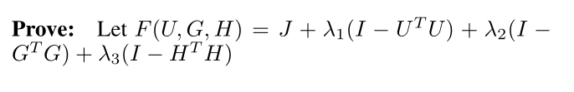
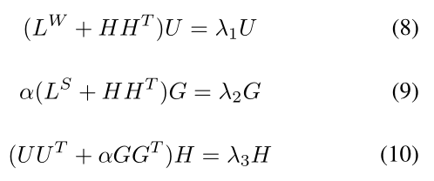
The Learning Algorithm
Lagrange multiplier

Slide 17
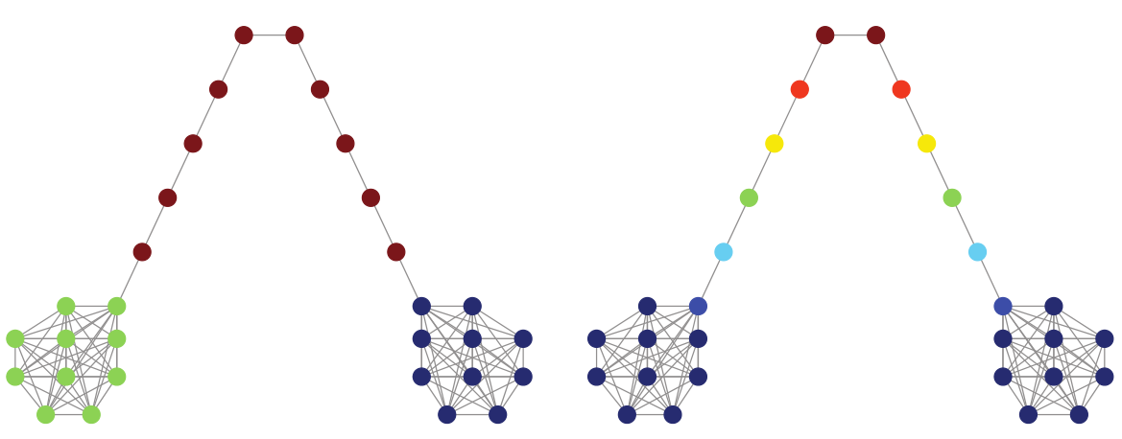
Experiment — Unsupervised clustering
Run clustering method on the final embedding
Different communities
Same
Community
community structures
structural equivalence
flexible
Notes:
synthetic

Slide 18
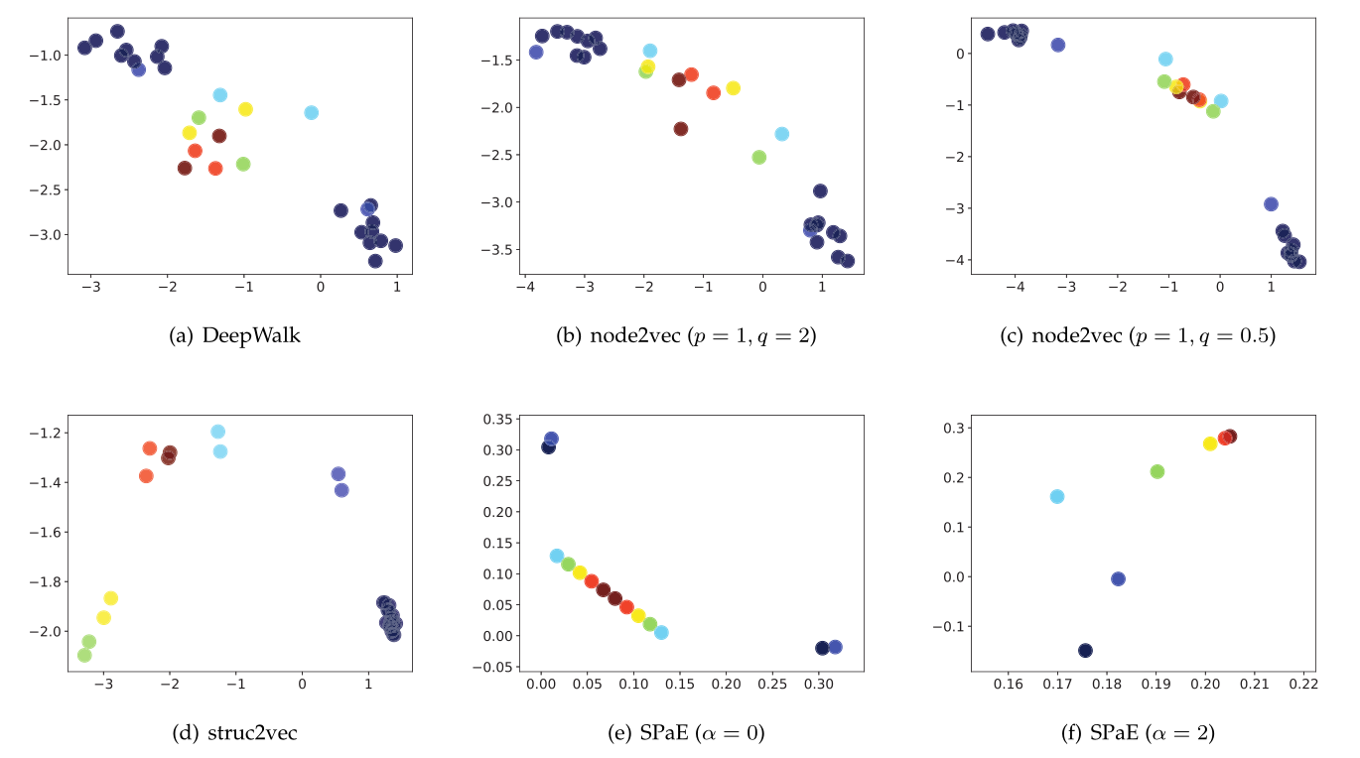
The barbell network latent representations in ${ R}^{2}$
(setting the dimention of embedding d = 2 )

Slide 19
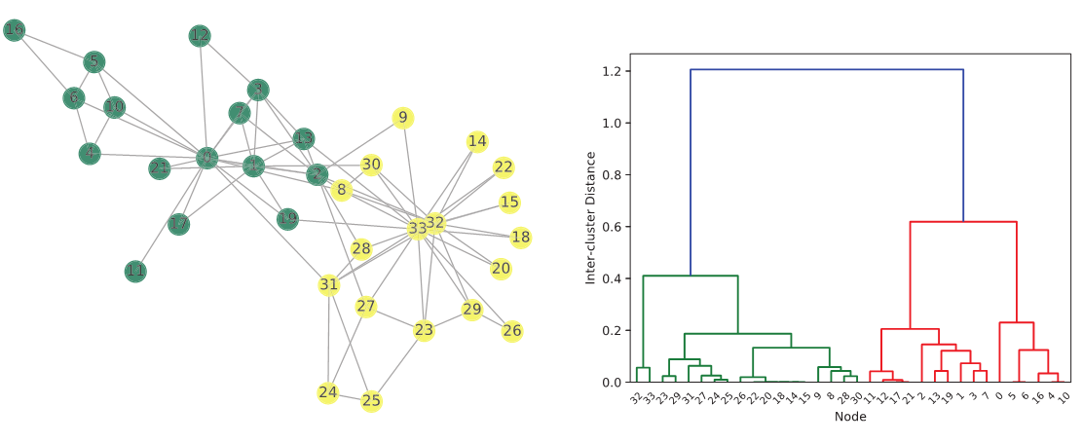
Karate Network
Instructor “Mr. Hi”
Administrator “John A”
Community structures
Notes:
Real world data

Slide 20
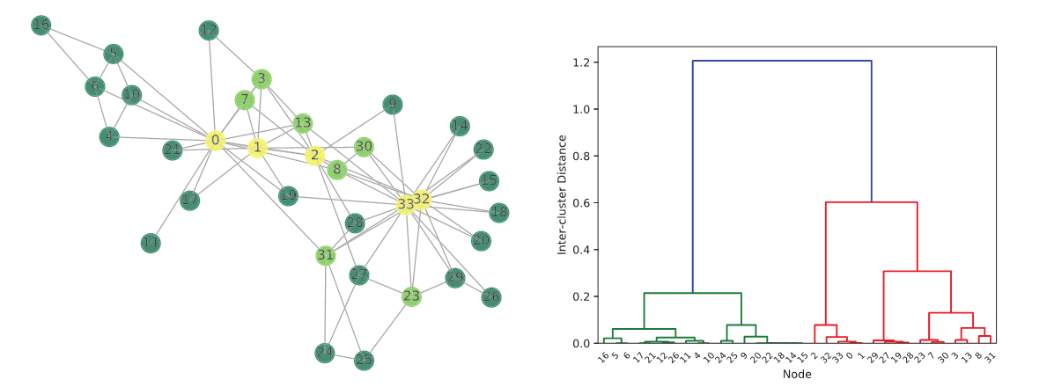
Karate Network
Instructor “Mr. Hi”
Administrator “John A”
Structural equivalence（role）
Notes:
manager

Slide 21
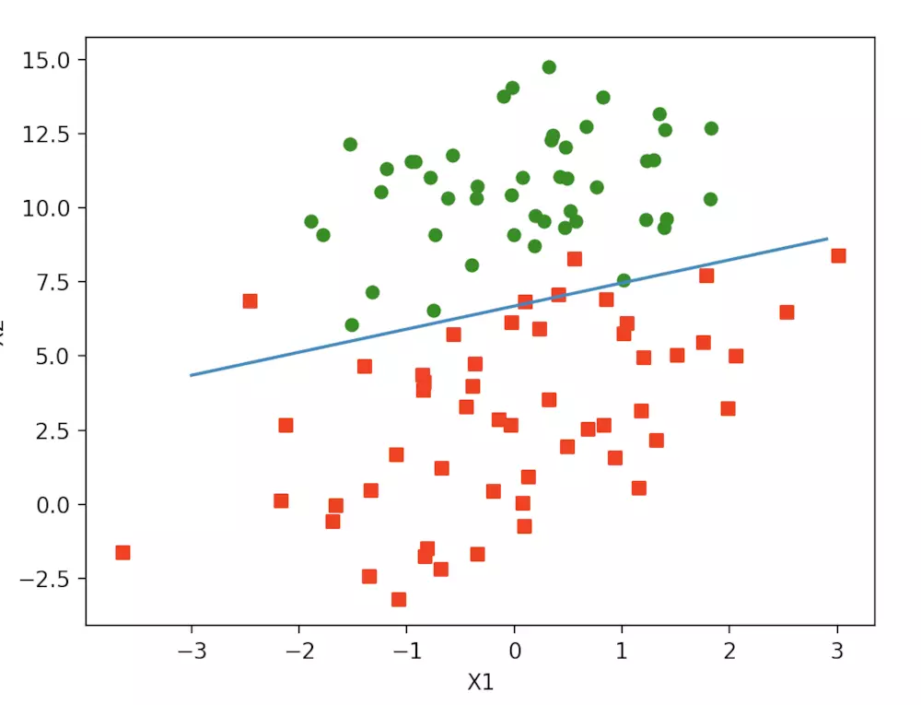
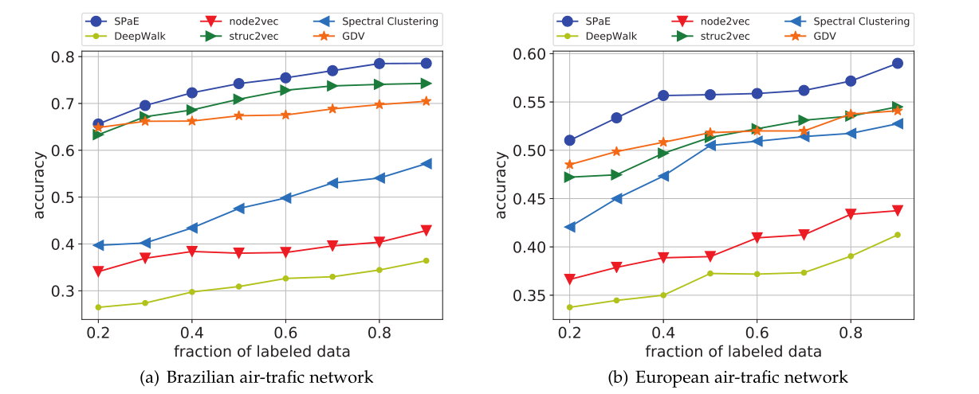
Supervised — Node Classification
logistic classifier
Use labels and embeddings to train a logistic classifier
embeddings

Slide 22
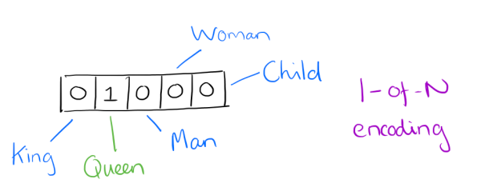
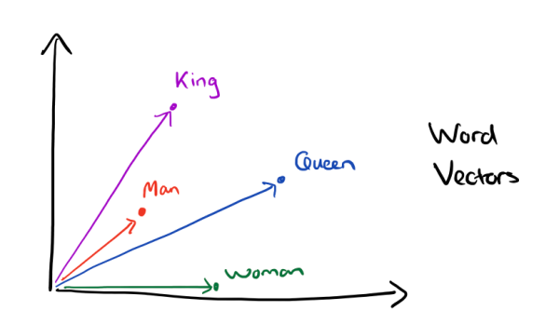
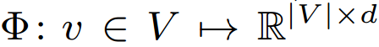
Random Walk-based Approach
Natural Language Process (NPL)
One Hot representation
1000 word in dictionary : vector of 1000 dimensions
Word2vec
Learning a representation means learning a mapping function from word co-occurrence
Man – King ≈ Woman - Queen
Notes:
任何one-hot距离都是1

Slide 23
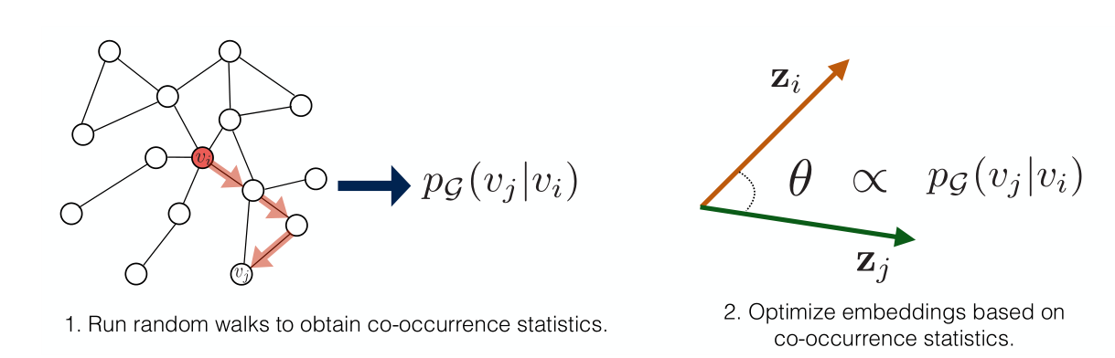
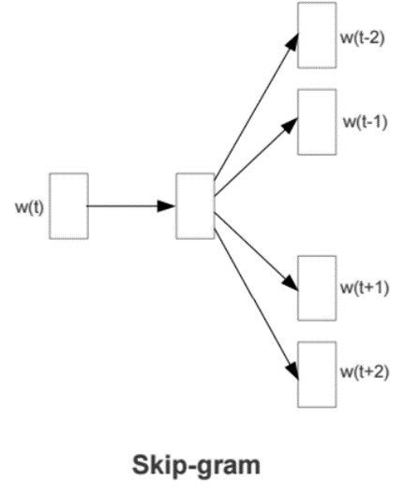
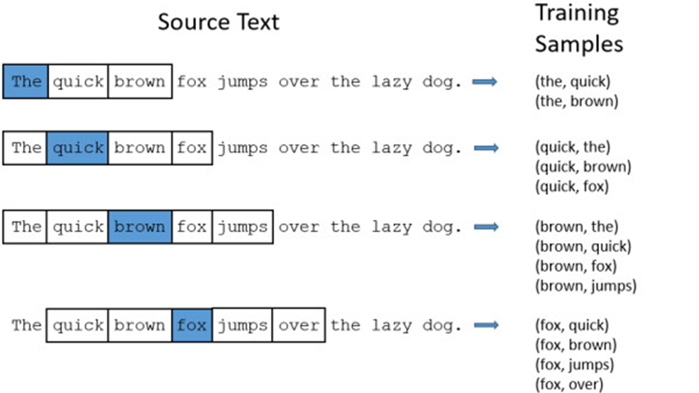
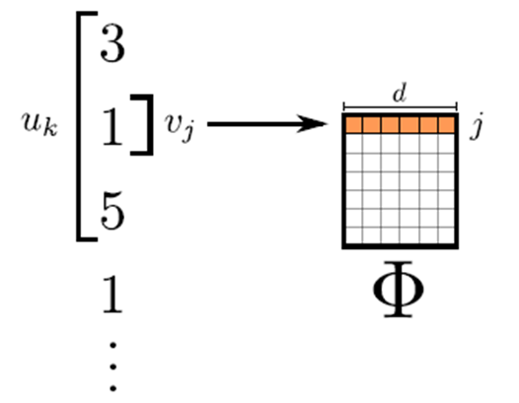
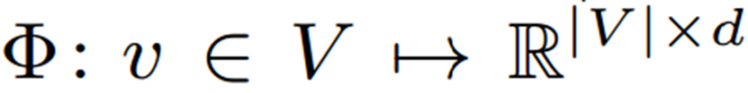
DeepWalk
Employ random walks on the graph to discover the structure
Random walks in Network
=
Sentences in NLP
Node sequence as the input of word2vec models
word2vec
models
Perozzi B, Al-Rfou R, Skiena S. Proceedings of the 20th ACM SIGKDD. ACM, 2014
Notes:
Cited by 1877

Slide 24
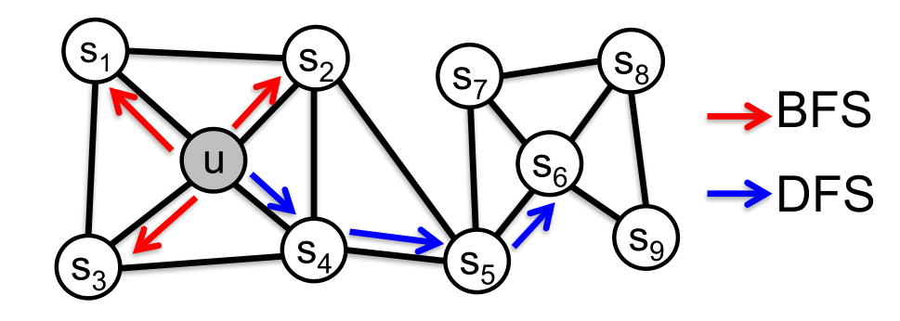
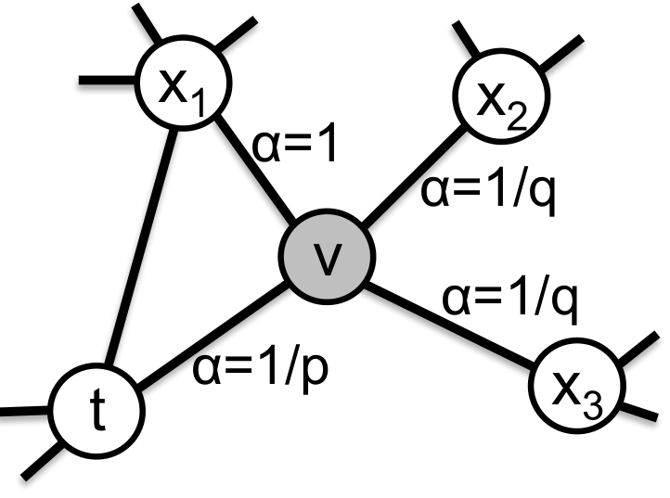
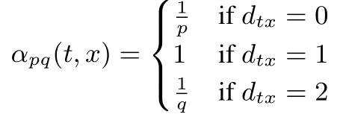
Node2Vec
Biased random walks
p: controls the walk revisiting a node
q: controls the walk revisiting anode’s one-hop neighborhood
p increase ⇒ DFS q increase ⇒ BFS
A. Grover and J. Leskovec. node2vec: Scalable feature learning for networks. In KDD, 2016
Notes:
Cited by 1877

Slide 25
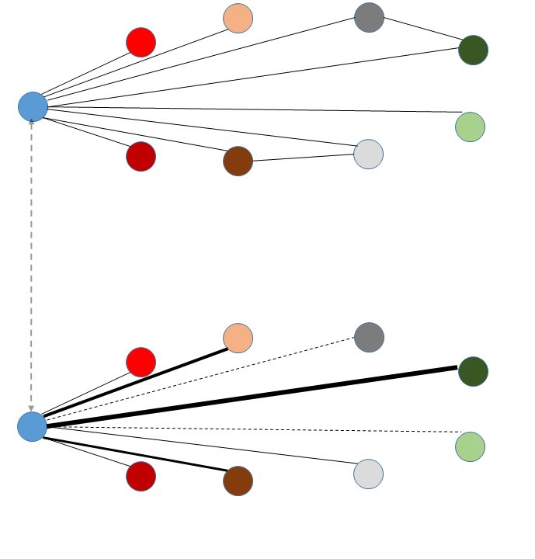
Unsupervised Cross-layer Random Walks
Build a 2-layer network
-- One layer based on community
-- The other based on node role
Random walks on the 2-layer network
-- A hyperparameter
Use CBOW or SkipGram to obtain embeddings
Sample based on proximity
(local community level )
Cross-layer Random Walks
The original adjacency network W
Sample based on similarity
( global role level )
More efficient than matrix factorization-based methods
The role-based similarity network S

Slide 26
Semi-Supervised Cross-layer Random Walks
High probability
Label A
Label A
Label B
Guide the random walks using label information in a supervised manner
The Orignal Adjacency Network W
Cross-layer Random Walks
Label A
Label A
Label B
The Role-based Similarity Network S
Notes:
1736 when Euler used it to solve ”Konigsberger Brucken-
problem”

Slide 27
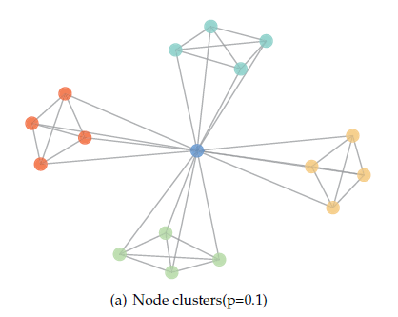
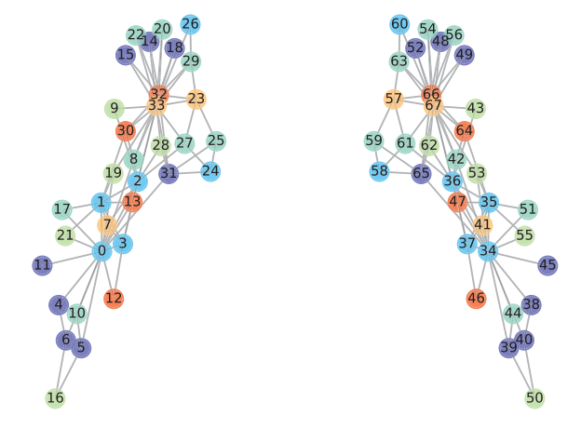

Experimental Results: Clustering
The mirrored Karate network.

Slide 28

Experimental Results: Transductive Classification
4 categories
4 categories
42 categories
7 categories

Slide 29

EpiRep: Representing Epidemic Dynamics
Notes:
1736 when Euler used it to solve ”Konigsberger Brucken-
problem”

Slide 30






Epidemic Dynamics
SIR Model
S
$$β$$
I
$$γ$$
R
S: Susceptible; I: Infected; R: Recovered
$$\left\{\begin{aligned}\frac{dS}{dt}=−βSI \\ \frac{dI}{dt}= βSI −γI \\ \frac{dR}{dt}= γI \\ S+I+R=1\end{aligned}\right.$$
Notes:
1736 when Euler used it to solve ”Konigsberger Brucken-
problem”

Slide 31



Epidemic Dynamics on Networks: The SI Model
The Gillespie algorithm:
Different from Random Walks:
The Markov property does not hold
The time of infection

Slide 32

Epidemic Dynamics on Networks: The SI Model
The Gillespie algorithm:
Different from Random Walks:
The Markov property does not hold
The time of infection

Slide 33
Random Walks VS Epidemic Dynamics
(Biased) Random Walks
(u, s₄, s₅, s₆, s₉)
Epidemic Dynamics
(u(t₀), s₄(t₁), s₅(t₂), s₂(t₃) s₆(t₄))
The Markov property holds
No time information
The Markov property does not hold
Time of infection

Slide 34


EpiRep: The CBOW Method
Objectives:
(u(t₀), s₄(t₁), s₅(t₂), s₂(t₃), s₆(t₄))
(u(t₀), s₄(t₁), s₅(t₂), s₂(t₃))
(u(t₀), s₄(t₁), s₅(t₂))
(u(t₀), s₄(t₁))
where:
Represent the vulnerability of network nodes

Slide 35



EpiRep: The CBOW Method

Slide 36

EpiRep: The SkipGram Method
(u(t₀), s₄(t₁), s₅(t₂), s₂(t₃), s₆(T))
(u(t₀), s₄(t₁), s₂(t₂), s₅(T))
(u(t₀), s₁(t₁), s₃(t₂), s₅(T)))
(u(t₀), s₄(t₁), s₃(T))
… …
Represent the infectiousness of network nodes

Slide 37

Experimental Results: Clustering and Visualization

Slide 38

Experimental Results: The Karate Network
Notes:
1736 when Euler used it to solve ”Konigsberger Brucken-
problem”

Slide 39


Experimental Results: Node Classification
Notes:
1736 when Euler used it to solve ”Konigsberger Brucken-
problem”

Slide 40
Future Directions of the EpiRep Method
Identifying influential or vulnerable nodes in networks
Measuring “communities” in terms of epidemic measures
Comparing with other epidemic models (IC model)
Designing semi-supervised classification algorithms based on label propagation

Slide 41




On-going Work: Higher-order GNNs
Graph Neural Networks
Interpretable and efficient GNNs
Graph Convolutional Network
GraphSAGE
Graph Attention Networks
Graph neural networks for evolving graphs
Leverage node attributes and labels during learning stage
Incorporating task-specific supervision

Slide 42
Thank you!

